Slide 1

What’s New in Worldview
Presentation by Zachary Rice

Slide 2
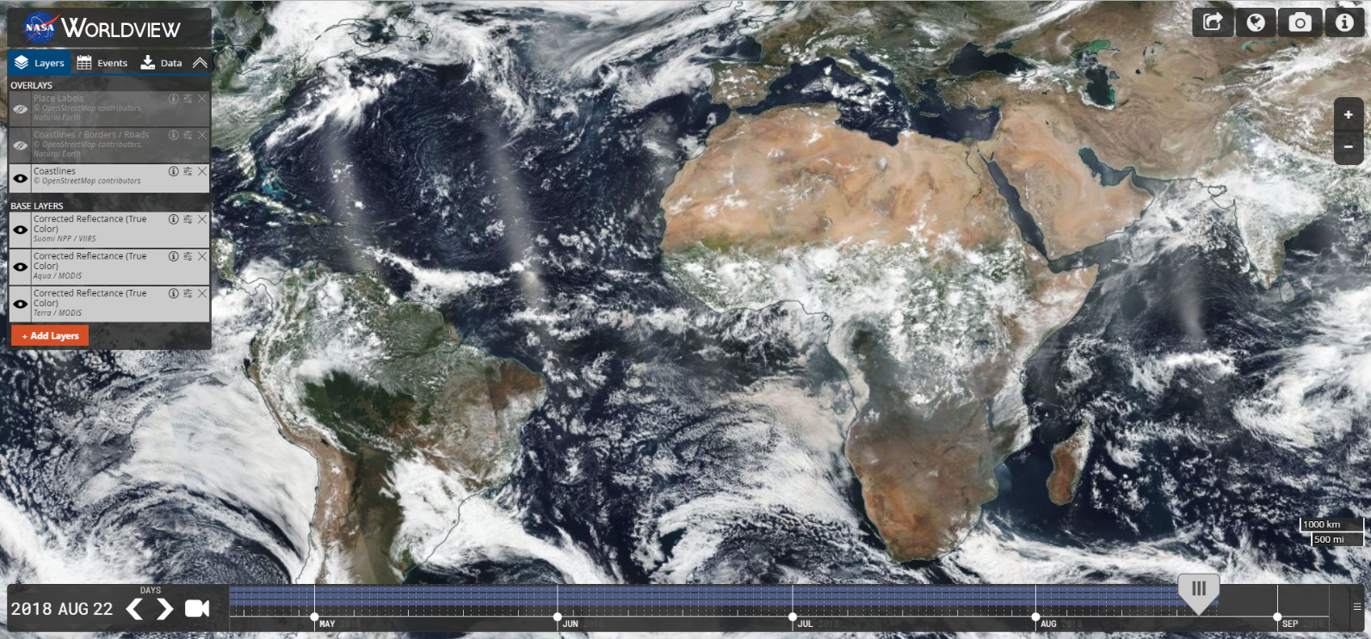




Major Releases
v2.0.0 & v2.1.0
Refactored codebase to use ES6 modules
Simplified build scripts
Improved developer tools
v2.2.0
Improved Snapshot & GIF resolution
v2.3.0
Sub-daily layer support
v2.4.0 & v2.5.0
Multi-day event tracking
v2.6.0
Natural events in polar projection views
v2.7.0
Vector layer support
V2.8.0
Support selecting layers with future dates
v2.9.0 (September 2018)
“A|B” Comparison Mode

Slide 3
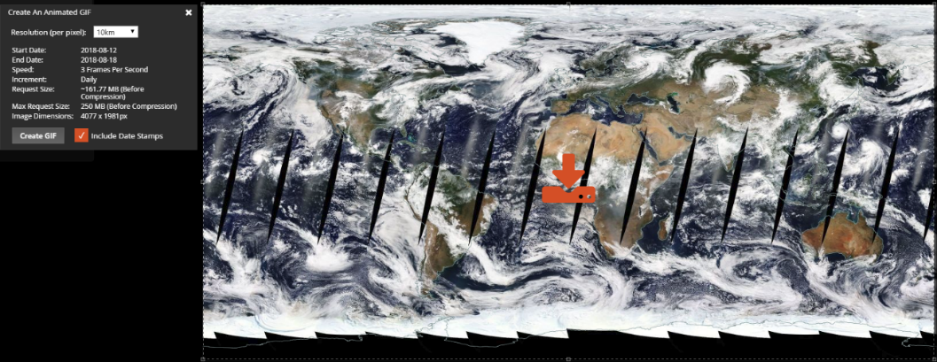
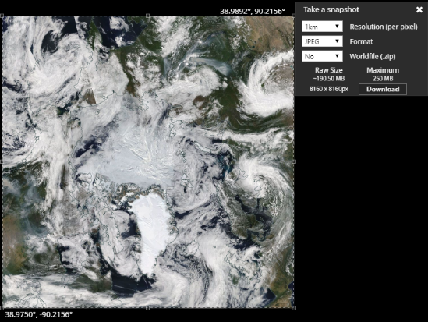
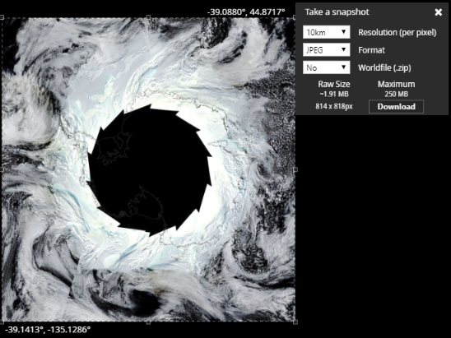
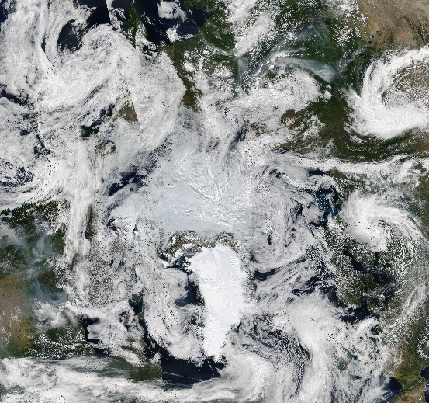
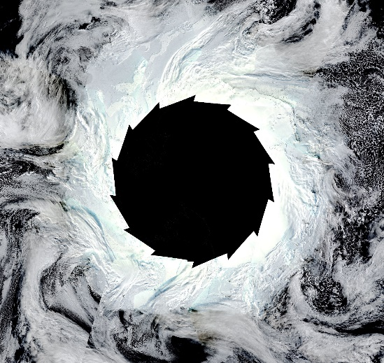
Improved Image Resolution
High-Resolution Animated GIFs
High-Resolution Image Snapshots
7-Day Animation of Geographic Projection at 10km
Arctic & Antarctic Projections at 1km

Slide 4
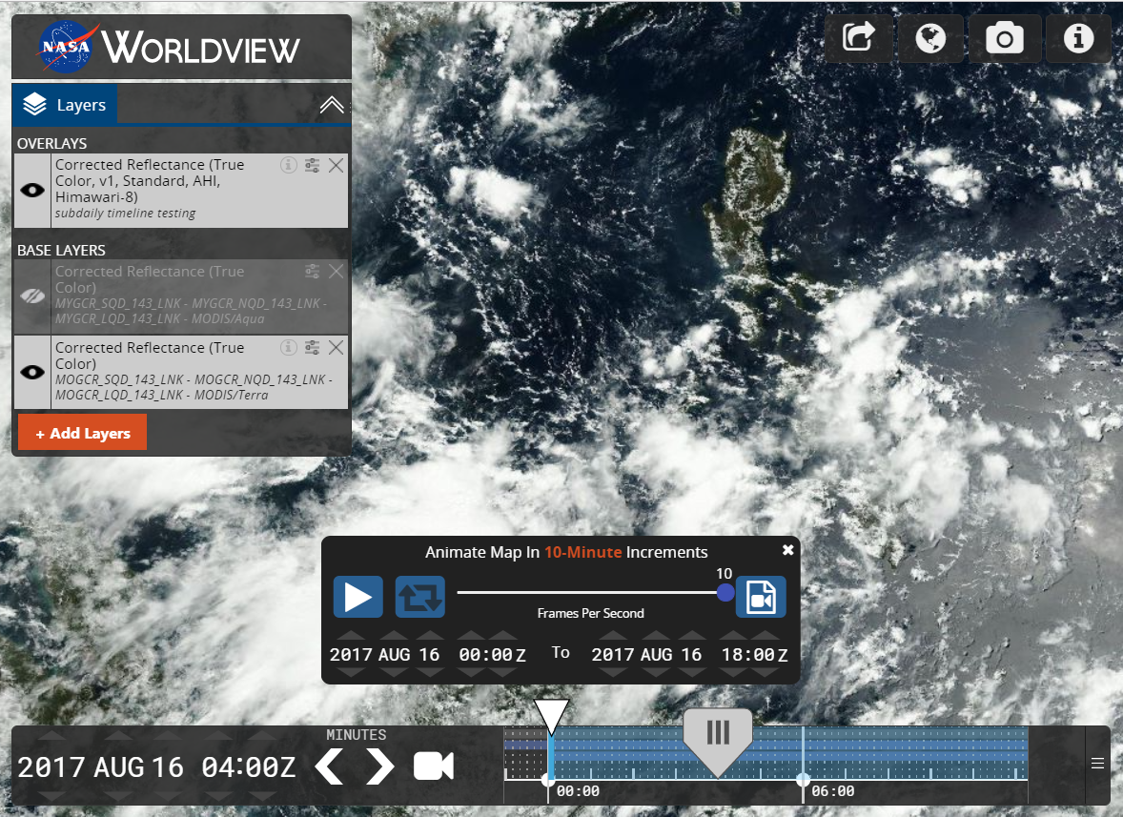
Sub-daily Timeline Support
10-Mintue Timeline Zoom

Slide 5
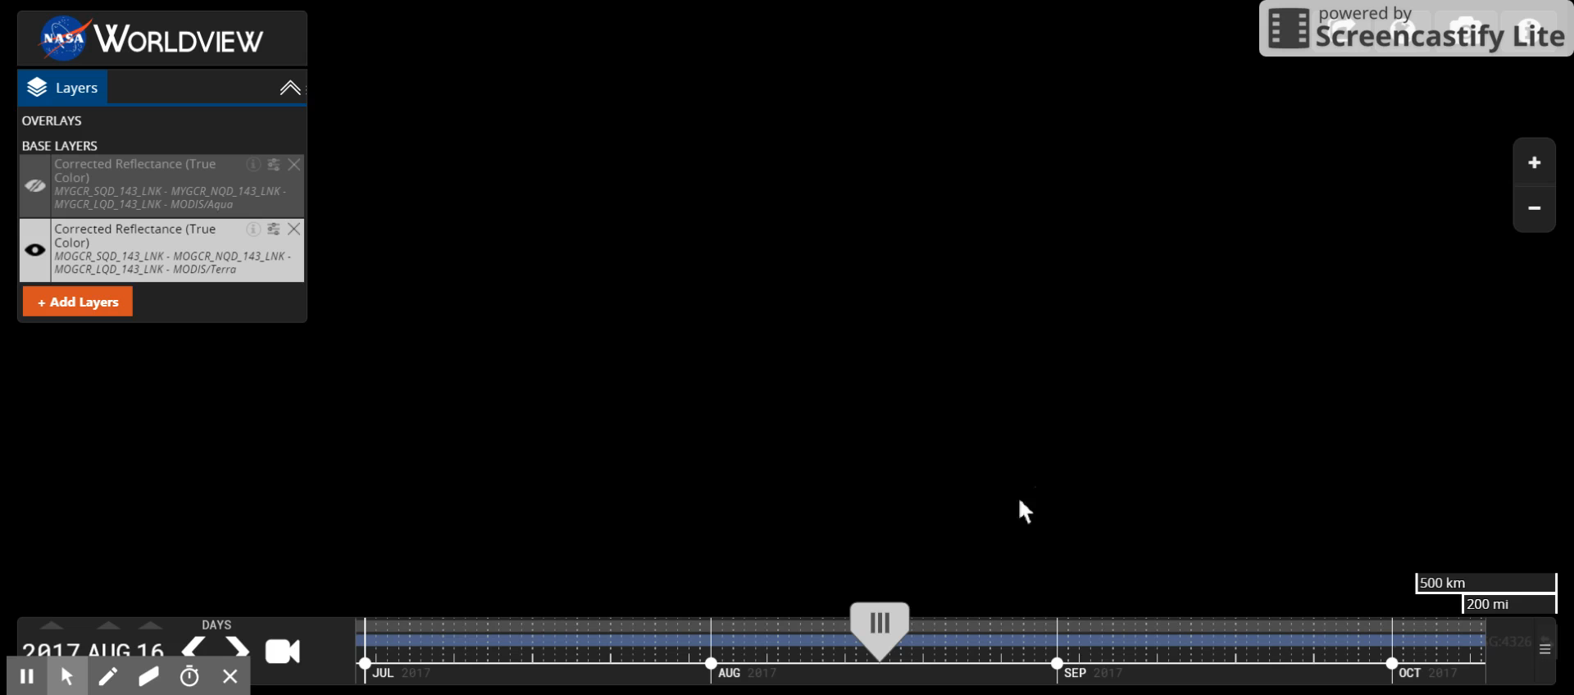
Sub-daily Timeline Support

Slide 6
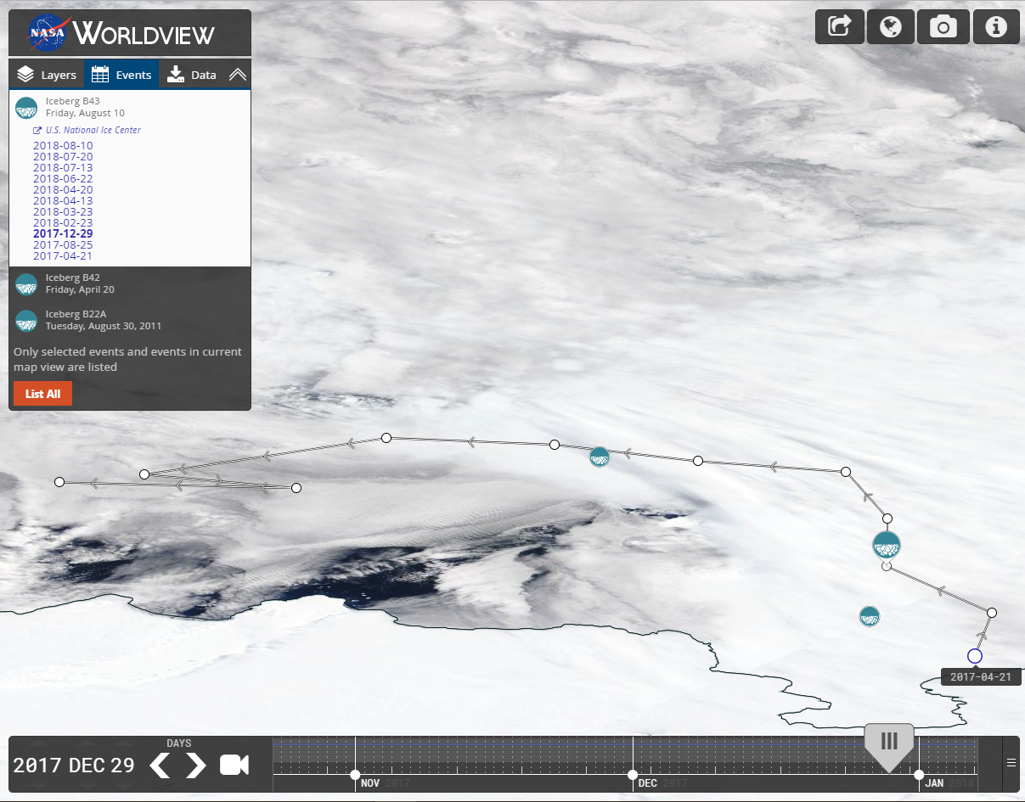
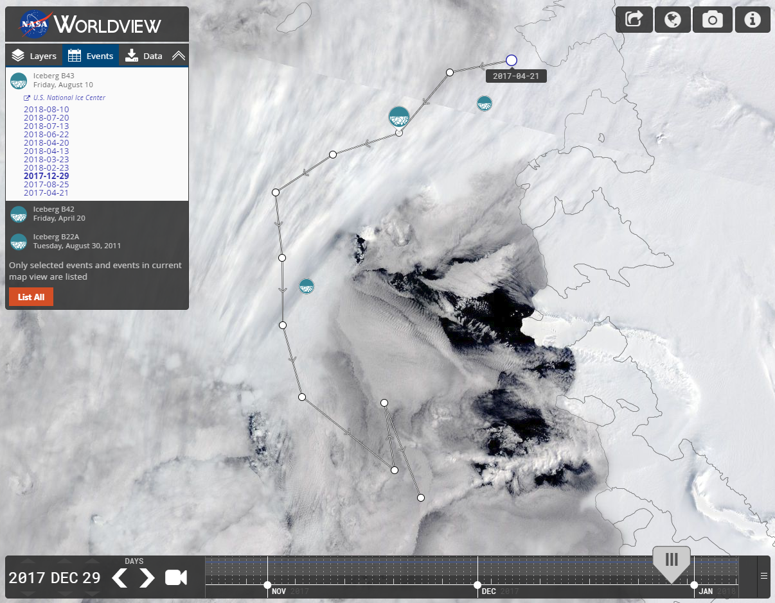
Event Tracks & Polar Events
Event Tracking
Polar Projection Support

Slide 7
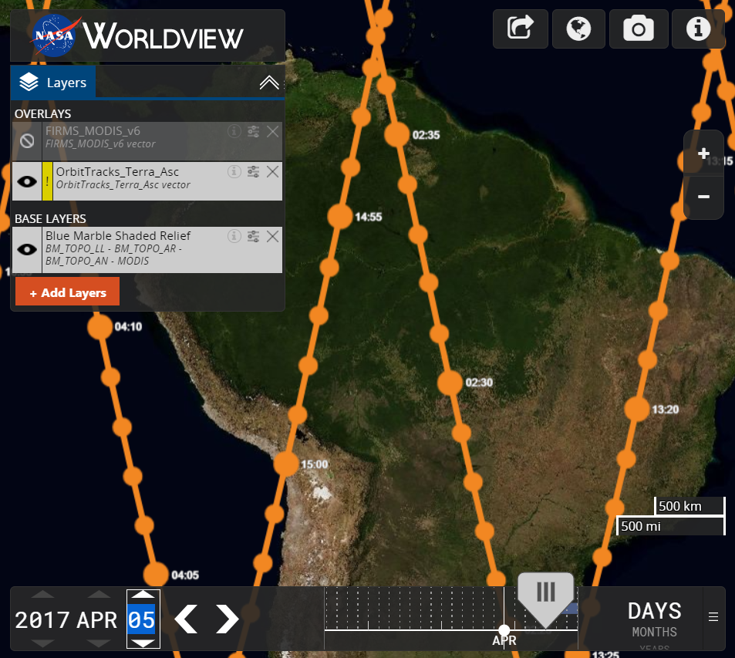
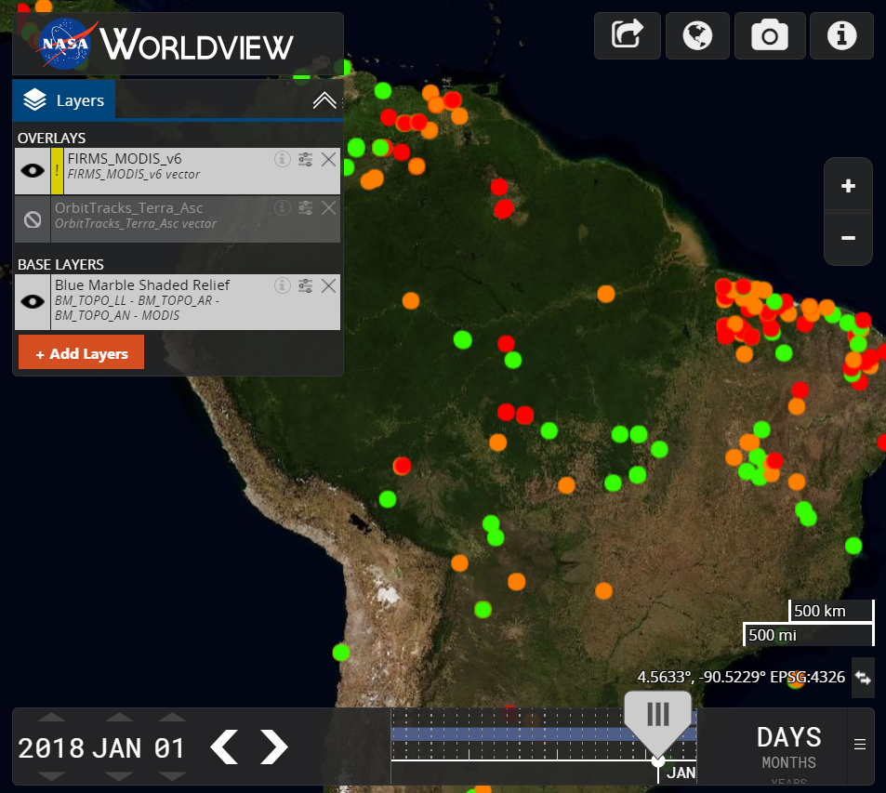
Vector Support
Orbit Tracks
FIRMS MODIS v6 Fires

Slide 8
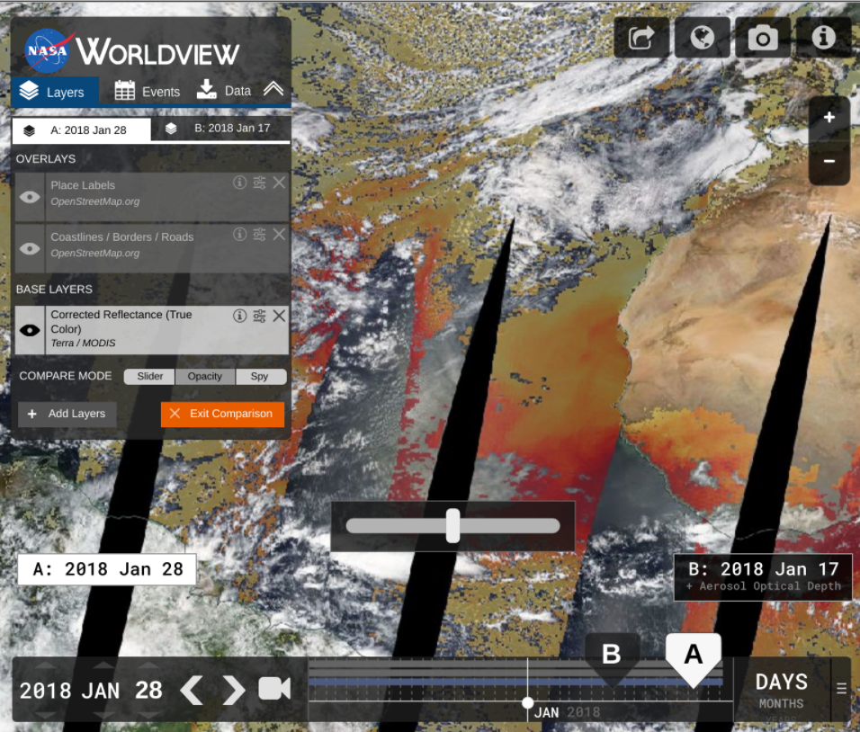
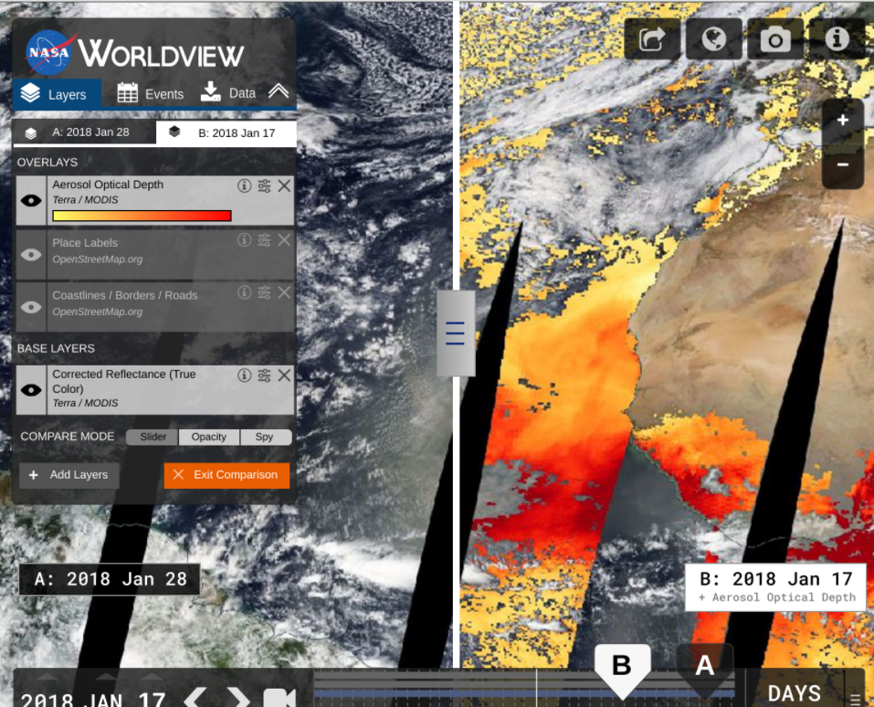
Comparison Mode
Opacity Mode
Swipe Mode

Slide 9
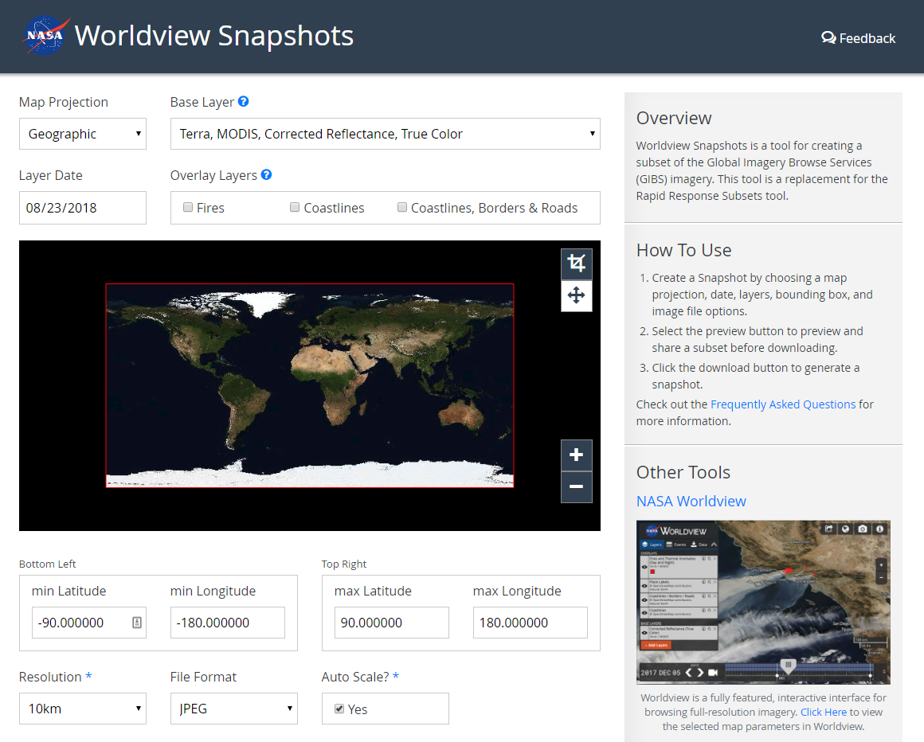
Short-Term Goals
Worldview Snapshots Tool
Startup Tour/Tutorial
Show users new / popular events
Advanced Vector Support
Styling based on vector features
Vector point tooltips
Revamped Image Download
Capture imagery across the dateline
Vector download capabilities
Add additional meta to downloads (legends, color bars, time stamps, etc.)
Updates to OpenStreetMap Layers

Slide 10
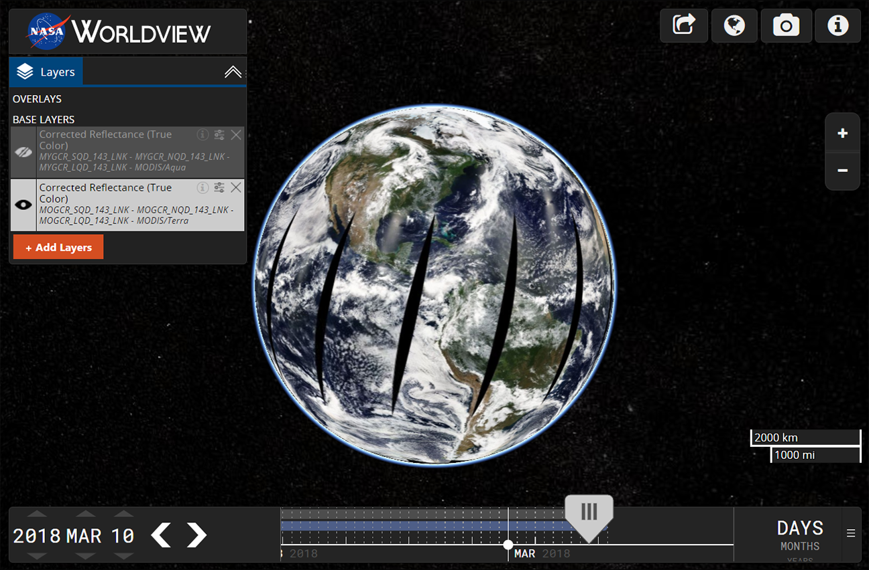
Mid to Long-Term Goals
Historical Event Browsing
UI Overhaul
Improved Data Download
Improved Timeline
Gazetteer / Omni search box
Search for places, lat/long, layers, etc.
User Customization
Save settings, bookmarks, etc.
Crowdsource event information
Virtual Globe / Data Curtains
Add features that support new missions…
Worldview 3D globe concept using Cesium

Slide 11
Thank You
More Resources & Links
Worldview on GitHub: https://github.com/nasa-gibs/worldview Release Notes: https://github.com/nasa-gibs/worldview/releases Project Roadmap: https://github.com/nasa-gibs/worldview/projects/7

